Slide 1
Transforming Linear Functions
Algebra I | Module 2 | Topic 2 | Lesson 1
1
Notes:
Note: Total suggested pacing for this lesson is three 45-minute sessions.

Slide 2
Objectives
Determine the effects on the graph of a linear function when f(x) is replaced by f(x) + d or a ∙ f(x).
Graph linear function transformations expressed symbolically and show intercepts.
Identify key characteristics of the graphs of linear functions, such as slope and y-intercept, in terms of quantities from a verbal description.
Prove that a translated line and its pre-image have the same slope and are, therefore, parallel.
Write equations of parallel lines.
SE p. 269
2
Notes:
TEKS:
A.1F: analyze mathematical relationships to connect and communicate mathematical ideas.
A.1G: display, explain, and justify mathematical ideas and arguments using precise mathematical language in written or oral communication.
A.2A: determine the domain and range of a linear function in mathematical problems, determine reasonable domain and range values for real-world situations, both continuous and discrete; and represent domain and range using inequalities.
A.2C: write linear equations in two variables given a table of values, a graph, and a verbal description.
A.2E: write the equation of a line that contains a given point and is parallel to a given line.
A.3C: graph linear functions on the coordinate plane and identify key features, including x-intercept, y-intercept, zeros, and slope, in mathematical and real-world problems.
A.3E: determine the effects on the graph of the parent function f(x) = x when f(x) is replaced by af(x), f(x) + d, f(x − c), f(bx) for specific values of a, b, c, and d.
ELPS:
2.H: understand implicit ideas and information in increasingly complex spoken language commensurate with grade-level learning expectations.
3.F: ask and give information ranging from using a very limited bank of high-frequency, high-need, concrete vocabulary, including key words and expressions needed for basic communication in academic and social contexts, to using abstract and content-based vocabulary during extended speaking assignments.
4.F: use visual and contextual support and support from peers and teachers to read grade-appropriate content area text, enhance and confirm understanding, and develop vocabulary, grasp of language structures, and background knowledge needed to comprehend increasingly challenging language.

Slide 3
Key Term
parent function: the simplest function of its type
Example
  f(x) = x is the parent function for the linear function family
SE p. 272
3
Notes:
Note: Parent function is introduced on Day 1.

Slide 4
Essential Question (1 of 3)
You have learned about linear functions and their characteristics, including slope and y-intercept.
How can you transform a function? What effects do different transformations have on the characteristics of linear functions?
Translation: y = f(x) + d moves the graph up (d > 0) or down (d < 0) by |d| units. The slope stays the same, so the new line is parallel to the original; the y-intercept changes.
Dilation: y = a · f(x) stretches the graph vertically when |a| > 1 and compresses it when 0 < |a| < 1; when a < 0 it is also reflected across the x-axis. The slope changes; for f(x) = x the new slope is a.
SE p. 269
4
Notes:
Setting the Stage:
Tap into your students’ prior learning by reading the narrative statement.
Provide a sense of direction by reading the Essential Question.

Slide 5
Day 1
1
5
Notes:
Note: Total suggested pacing for Day 1 is 45 minutes.

Slide 6
Getting Started
★ Essential activity: do not skip
15–20
6
Notes:
Note: Total time of 15-20 minutes allotted for the Getting Started.

Slide 7
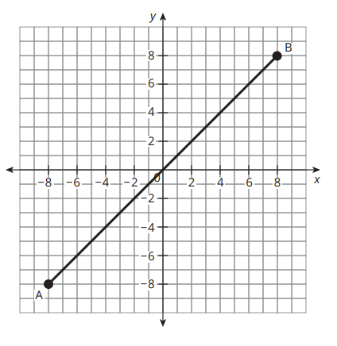
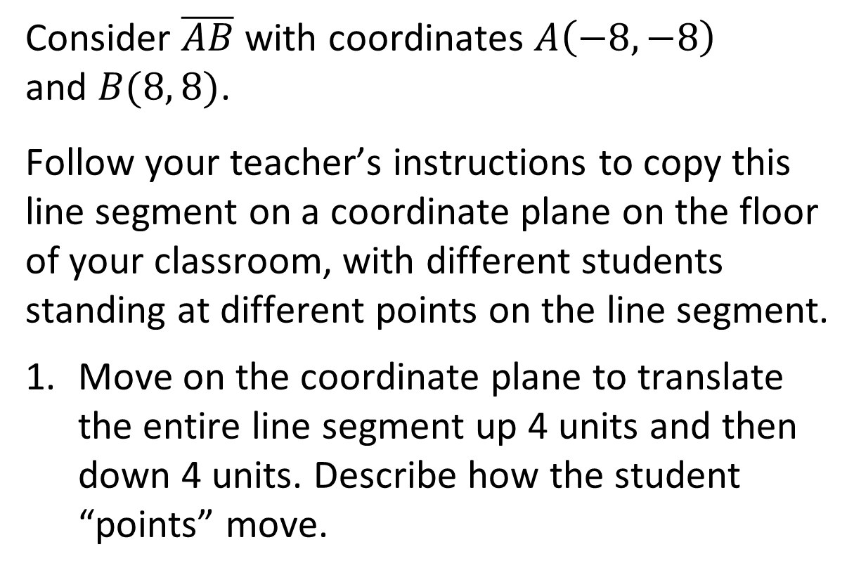
Returning to Transformation Station (1 of 8)
Consider $\overline{AB}$ with coordinates $A\left(−8, −8\right)$
and $B(8, 8)$.
Follow your teacher’s instructions to copy this line segment on a coordinate plane on the floor of your classroom, with different students standing at different points on the line segment.
Move on the coordinate plane to translate the entire line segment up 4 units and then down 4 units. Describe how the student “points” move.
The points move straight up or straight down. There is no movement left or right.
★ Essential · SE p. 270
7
Notes:
Questions to Support Discourse – Gathering:
What does translate mean?
Questions to Support Discourse – Probing:
When you moved on the coordinate plane, did you change the x-value or y-value of the original coordinate pair? Explain.
Does the translated line still go through the origin? Why not?
Questions to Support Discourse – Seeing Structure:
What’s the difference between the y-values on the original and translated lines for the same x-value?
What does the y in y + 4 represent?
Questions to Support Discourse – Probing:
Why are the lines parallel?
Compare the y-intercepts.
When you moved on the coordinate plane, did you change the x-value or y-value of the original coordinate pair? Explain your thinking.
Does the newly graphed line still pass through the origin? Why?
Why does it make sense that the line is steeper?
Questions to Support Discourse – Seeing Structure:
How are the lines graphed by multiplying by 2 and −2 the same? Different?

Slide 8
Returning to Transformation Station (2 of 8)
How do the translations affect the coordinates of the figure?
Original Point | 4 Units Up | 4 Units Down
(x, y)
(x, y + 4)
(x, y − 4)
★ Essential · SE p. 270
8
Notes:
Questions to Support Discourse – Gathering:
What does translate mean?
Questions to Support Discourse – Probing:
When you moved on the coordinate plane, did you change the x-value or y-value of the original coordinate pair? Explain.
Does the translated line still go through the origin? Why not?
Questions to Support Discourse – Seeing Structure:
What’s the difference between the y-values on the original and translated lines for the same x-value?
What does the y in y + 4 represent?
Questions to Support Discourse – Probing:
Why are the lines parallel?
Compare the y-intercepts.
When you moved on the coordinate plane, did you change the x-value or y-value of the original coordinate pair? Explain your thinking.
Does the newly graphed line still pass through the origin? Why?
Why does it make sense that the line is steeper?
Questions to Support Discourse – Seeing Structure:
How are the lines graphed by multiplying by 2 and −2 the same? Different?

Slide 9
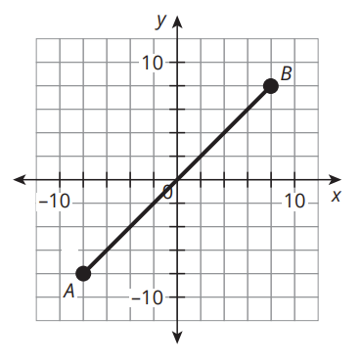
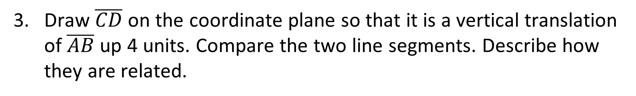
Returning to Transformation Station (3 of 8)
Draw $\overline{CD}$ on the coordinate plane so that it is a vertical translation of $\overline{AB}$ up 4 units. Compare the two line segments. Describe how they are related.
C(−8, −4) and D(8, 12): every point of AB moves up 4.
The segments are parallel, with CD 4 units above AB.
★ Essential · SE p. 270
9
Notes:
Questions to Support Discourse – Gathering:
What does translate mean?
Questions to Support Discourse – Probing:
When you moved on the coordinate plane, did you change the x-value or y-value of the original coordinate pair? Explain.
Does the translated line still go through the origin? Why not?
Questions to Support Discourse – Seeing Structure:
What’s the difference between the y-values on the original and translated lines for the same x-value?
What does the y in y + 4 represent?
Questions to Support Discourse – Probing:
Why are the lines parallel?
Compare the y-intercepts.
When you moved on the coordinate plane, did you change the x-value or y-value of the original coordinate pair? Explain your thinking.
Does the newly graphed line still pass through the origin? Why?
Why does it make sense that the line is steeper?
Questions to Support Discourse – Seeing Structure:
How are the lines graphed by multiplying by 2 and −2 the same? Different?

Slide 10
Returning to Transformation Station (4 of 8)
Move back to where you started. Then, multiply all the y-coordinates by 2 and then by −2. Describe how the student “points” move.
Each point moves straight up or down, away from the x-axis (twice as far). The segment gets steeper: a vertical stretch. When the factor is −2, the points also reflect across the x-axis.
★ Essential · SE p. 271
10
Notes:
Questions to Support Discourse – Gathering:
What does translate mean?
Questions to Support Discourse – Probing:
When you moved on the coordinate plane, did you change the x-value or y-value of the original coordinate pair? Explain.
Does the translated line still go through the origin? Why not?
Questions to Support Discourse – Seeing Structure:
What’s the difference between the y-values on the original and translated lines for the same x-value?
What does the y in y + 4 represent?
Questions to Support Discourse – Probing:
Why are the lines parallel?
Compare the y-intercepts.
When you moved on the coordinate plane, did you change the x-value or y-value of the original coordinate pair? Explain your thinking.
Does the newly graphed line still pass through the origin? Why?
Why does it make sense that the line is steeper?
Questions to Support Discourse – Seeing Structure:
How are the lines graphed by multiplying by 2 and −2 the same? Different?

Slide 11
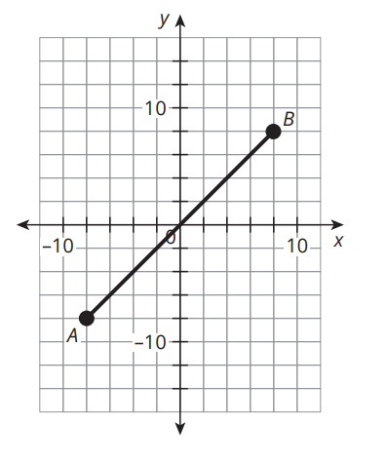
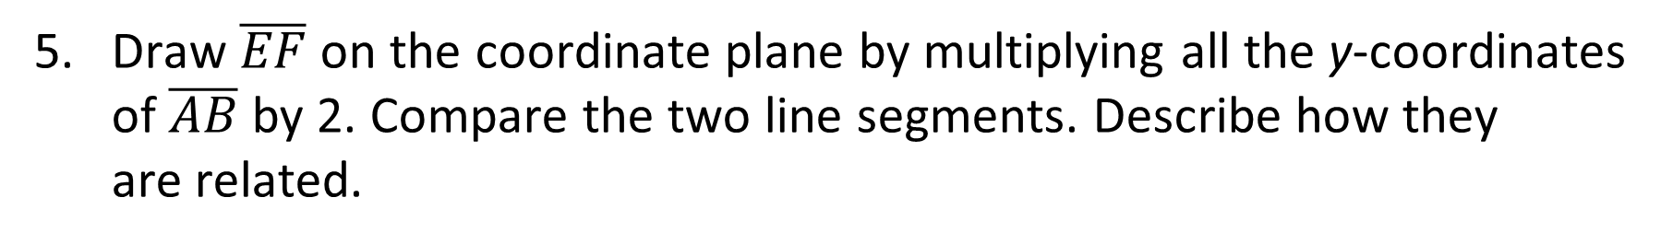
Returning to Transformation Station (5 of 8)
Draw $\overline{EF}$ on the coordinate plane by multiplying all the y-coordinates of $\overline{AB}$ by 2. Compare the two line segments. Describe how they
are related.
E(−8, −16) and F(8, 16).
EF is steeper than AB (stretched vertically by a factor of 2); both pass through the origin.
★ Essential · SE p. 271
11
Notes:
Questions to Support Discourse – Gathering:
What does translate mean?
Questions to Support Discourse – Probing:
When you moved on the coordinate plane, did you change the x-value or y-value of the original coordinate pair? Explain.
Does the translated line still go through the origin? Why not?
Questions to Support Discourse – Seeing Structure:
What’s the difference between the y-values on the original and translated lines for the same x-value?
What does the y in y + 4 represent?
Questions to Support Discourse – Probing:
Why are the lines parallel?
Compare the y-intercepts.
When you moved on the coordinate plane, did you change the x-value or y-value of the original coordinate pair? Explain your thinking.
Does the newly graphed line still pass through the origin? Why?
Why does it make sense that the line is steeper?
Questions to Support Discourse – Seeing Structure:
How are the lines graphed by multiplying by 2 and −2 the same? Different?

Slide 12
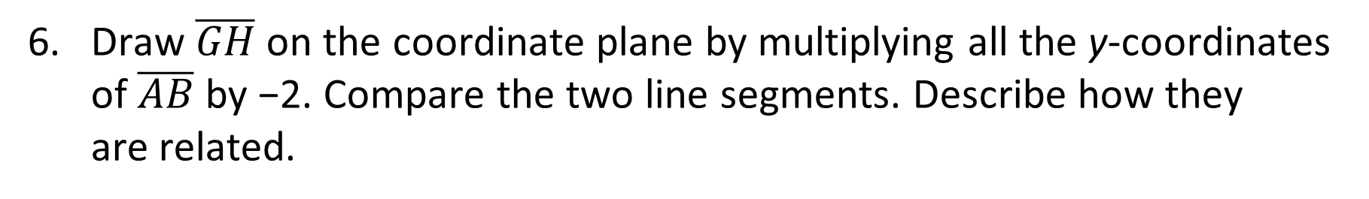
Returning to Transformation Station (6 of 8)
Draw $\overline{GH}$ on the coordinate plane by multiplying all the y-coordinates of $\overline{AB}$ by −2. Compare the two line segments. Describe how they
are related.
G(−8, 16) and H(8, −16).
GH is steeper than AB, and it is reflected across the x-axis.
★ Essential · SE p. 271
12
Notes:
Questions to Support Discourse – Gathering:
What does translate mean?
Questions to Support Discourse – Probing:
When you moved on the coordinate plane, did you change the x-value or y-value of the original coordinate pair? Explain.
Does the translated line still go through the origin? Why not?
Questions to Support Discourse – Seeing Structure:
What’s the difference between the y-values on the original and translated lines for the same x-value?
What does the y in y + 4 represent?
Questions to Support Discourse – Probing:
Why are the lines parallel?
Compare the y-intercepts.
When you moved on the coordinate plane, did you change the x-value or y-value of the original coordinate pair? Explain your thinking.
Does the newly graphed line still pass through the origin? Why?
Why does it make sense that the line is steeper?
Questions to Support Discourse – Seeing Structure:
How are the lines graphed by multiplying by 2 and −2 the same? Different?

Slide 13

Returning to Transformation Station (7 of 8)
Let’s summarize our learning from the Getting Started!
★ Essential · SE p. 271
13
Notes:
Getting Started Summary:
When a line segment is vertically translated on the coordinate plane, the x-value of each point remains unchanged, and the y-value changes according to the translation.

Slide 14
Returning to Transformation Station (8 of 8)
★ Essential · SE p. 271
14
Notes:
Note: This slide is blank for optional use with displaying work.

Slide 15
Activity 1.1
★ Essential activity: do not skip
1.1
20–25
15
Notes:
Note: Total time of 20-25 minutes allotted for Activity 1.1.

Slide 16
Vertical Translations of Functions (1 of 10)
Let’s determine how translations impact the graph of the linear function f(x) = x. The function f(x) = x is the parent function for the linear function family. A parent function is the simplest function of its type.
★ Essential · SE p. 272
16

Slide 17

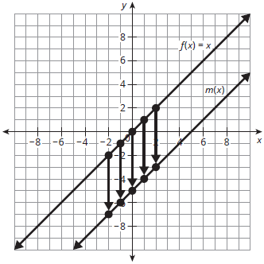
Vertical Translations of Functions (2 of 10)
You can translate the graph of f(x) down 5 units by moving each point 5 units down. The transformed graph is labeled as m(x).
To translate the point (−2, −2) on f(x), subtract 5 units from the output value, or y-value. The input value, or x-value, remains unchanged. The coordinates of the translated point on m(x) are (−2, −7). The coordinates of four additional points on f(x) are translated for you.
For the family of linear functions having the general form f(x) = ax + b, where a and b are any real numbers, the function
f(x) = x, where
a = 1 and b = 0, is the parent function. It is the simplest linear function.
Original Graph
Transformed Graph
x | f(x)
−2 | −2
−1 | −1
0 | 0
1 | 1
2 | 2
x | m(x)
−2 | −7
−1 | −6
0 | −5
1 | −4
2 | −3
★ Essential · SE p. 272
17

Slide 18
Vertical Translations of Functions (3 of 10)
Consider the translated function, m(x). Identify the slope and
y-intercept of the graph of the function. Then, write the equation for the function in general form.
Slope: 1; y-intercept: (0, −5)
m(x) = x − 5
★ Essential · SE p. 272
18
Notes:
Questions to Support Discourse – Probing:
Why is the y-intercept of the transformed graph (0, −5)?
Did you complete any calculations to determine the slope? Explain.
How did you determine the points that lie on p(x)?
Do vertical translations of f(x), such as p(x) and m(x), affect the range? Why not?
Questions to Support Discourse – Seeing Structure:
Explain the relationship between the graph, table, and equation.

Slide 19
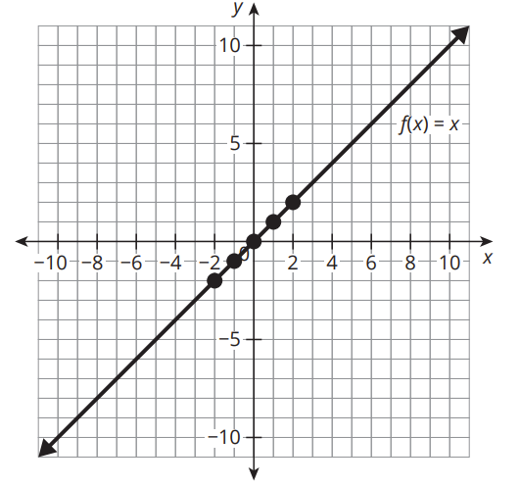
Vertical Translations of Functions (4 of 10)
Translate f(x) again to create a new function, p(x).
    Translate the graph of f(x) up 5 units. Label your graph as p(x). Complete the table of corresponding points on p(x).
Original Graph
Transformed Graph
x | f(x)
−2 | −2
−1 | −1
0 | 0
1 | 1
2 | 2
x | p(x)
3
4
5
6
7
Graph p(x): the line through (0, 5), parallel to f(x)
★ Essential · SE p. 273
19
Notes:
Questions to Support Discourse – Probing:
Why is the y-intercept of the transformed graph (0, −5)?
Did you complete any calculations to determine the slope? Explain.
How did you determine the points that lie on p(x)?
Do vertical translations of f(x), such as p(x) and m(x), affect the range? Why not?
Questions to Support Discourse – Seeing Structure:
Explain the relationship between the graph, table, and equation.

Slide 20
Vertical Translations of Functions (5 of 10)
    Identify the slope and y-intercept of the graph of the function. Then, write the equation for the function in general form.
Slope: 1; y-intercept: (0, 5)
p(x) = x + 5
★ Essential · SE p. 273
20
Notes:
Questions to Support Discourse – Probing:
Why is the y-intercept of the transformed graph (0, −5)?
Did you complete any calculations to determine the slope? Explain.
How did you determine the points that lie on p(x)?
Do vertical translations of f(x), such as p(x) and m(x), affect the range? Why not?
Questions to Support Discourse – Seeing Structure:
Explain the relationship between the graph, table, and equation.

Slide 21
Vertical Translations of Functions (6 of 10)
For the parent function f(x) = x, the transformed function y = f(x) + d shows a vertical translation of the function. This translation affects the output values, or y-values, of the function. For d > 0, the resulting graph vertically shifts up. For d < 0, the resulting graph vertically shifts down. The distance the graph is shifted is the absolute value of d, or |d|.
Compare the values of f(2) and p(2). How did the transformation of the function affect the value of the function at x = 2?
f(2) = 2 and p(2) = 7.
The vertical translation increased the value at x = 2 by 5.
★ Essential · SE p. 273
21
Notes:
Questions to Support Discourse – Probing:
Why is the y-intercept of the transformed graph (0, −5)?
Did you complete any calculations to determine the slope? Explain.
How did you determine the points that lie on p(x)?
Do vertical translations of f(x), such as p(x) and m(x), affect the range? Why not?
Questions to Support Discourse – Seeing Structure:
Explain the relationship between the graph, table, and equation.

Slide 22
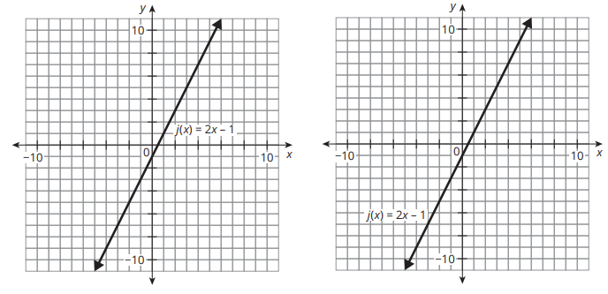
Vertical Translations of Functions (7 of 10)
    Consider the graph of j(x) = 2x − 1.
q(x) = j(x) + 4
Graph: the line through (0, 3), parallel to j(x)
    Translate the graph of j(x) up 4 units. Label the graph as q(x). Then, write an equation for q(x) in terms of j(x).
★ Essential · SE p. 274
22
Notes:
Questions to Support Discourse – Probing:
How did you know which operation to include with q(x)?
Explain how you rewrote each function in terms of x.
Questions to Support Discourse – Seeing Structure:
How is writing the equation of a translated function the same and different when the original function is not the parent function f(x) = x?

Slide 23
Vertical Translations of Functions (8 of 10)
    Translate the graph of j(x) down 4 units. Label the graph as r(x). Then, write an equation for r(x) in terms of j(x).
    Rewrite q(x) and r(x) in general form.
    Compare the equations and graphs of j(x), q(x), and r(x). What do you notice?
b. r(x) = j(x) − 4 (graph: the line through (0, −5), parallel to j(x))
c. q(x) = 2x + 3; r(x) = 2x − 5
Ask Yourself… Will the graphs of j(x), q(x), and r(x) ever intersect?
d. All three have slope 2 but different y-intercepts: (0, −1), (0, 3), (0, −5). The lines are parallel, so they never intersect.
★ Essential · SE p. 274
23
Notes:
Questions to Support Discourse – Probing:
How did you know which operation to include with q(x)?
Explain how you rewrote each function in terms of x.
Questions to Support Discourse – Seeing Structure:
How is writing the equation of a translated function the same and different when the original function is not the parent function f(x) = x?

Slide 24
Vertical Translations of Functions (9 of 10)
Let’s revisit the Essential Question and summarize our learning from Activity 1.1!
Essential Question: How can you transform a function? What effects do different transformations have on the characteristics
of linear functions?
★ Essential · SE p. 274
24
Notes:
Note: To close Day 1, have students reread the Essential Question and then read the Stamp the Learning summary aloud.
Activity 1.1 Summary:
For the parent function f(x) = x, the transformed function y = f(x) + d shows a vertical translation of the function. The slopes of vertically translated linear functions do not change, which means that the graphs of the functions are parallel lines.

Slide 25
Vertical Translations of Functions (10 of 10)
★ Essential · SE p. 274
25
Notes:
Note: This slide is blank for optional use with displaying work.

Slide 26
Day 2
2
26
Notes:
Note: Total suggested pacing for Day 2 is 45 minutes.

Slide 27
Essential Question (2 of 3)
How can you transform a function? What effects do different transformations have on the characteristics of linear functions?
SE p. 269
27
Notes:
Note: To begin Day 2, have a student read the Essential Question aloud.

Slide 28
Activity 1.2
★ Essential activity: do not skip
1.2
15–20
28
Notes:
Note: Total time of 15-20 minutes allotted for Activity 1.2.

Slide 29
Slopes of Parallel Lines (1 of 8)
In the previous activity, you translated the function j(x) = 2x − 1 up
4 units to create q(x) = 2x + 3.
Will the graphs of j(x) and q(x) ever intersect? Explain your reasoning.
No. Both lines have slope 2 and stay 4 units apart, so they are parallel.
★ Essential · SE p. 275
29
Notes:
Questions to Support Discourse – Probing:
Which line is the image? Which is the pre-image?
Questions to Support Discourse – Seeing Structure:
Are the x-coordinates, y-coordinates, or both, changed when completing a translation? How do you know?
Does the order of the coordinates matter when using the slope formula? Explain.

Slide 30
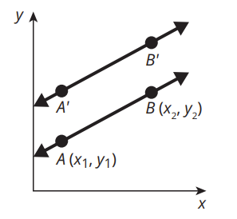
Slopes of Parallel Lines (2 of 8)
You can algebraically prove that a line and its translation are parallel to each other.
Line AB was translated a units up to create line A’B’.
★ Essential · SE p. 275
30
Notes:
Questions to Support Discourse – Probing:
Which line is the image? Which is the pre-image?
Questions to Support Discourse – Seeing Structure:
Are the x-coordinates, y-coordinates, or both, changed when completing a translation? How do you know?
Does the order of the coordinates matter when using the slope formula? Explain.

Slide 31
Slopes of Parallel Lines (3 of 8)
Identify the x- and y-coordinates of each corresponding point on the image.
Use the slope formula to calculate the slope of the pre-image.
Use the slope formula to calculate the slope of the image.
A′(x1, y1 + a) and B′(x2, y2 + a)
m = (y2 − y1) / (x2 − x1)
m = ((y2 + a) − (y1 + a)) / (x2 − x1) = (y2 − y1) / (x2 − x1)
★ Essential · SE p. 275
31
Notes:
Questions to Support Discourse – Probing:
Which line is the image? Which is the pre-image?
Questions to Support Discourse – Seeing Structure:
Are the x-coordinates, y-coordinates, or both, changed when completing a translation? How do you know?
Does the order of the coordinates matter when using the slope formula? Explain.

Slide 32
Slopes of Parallel Lines (4 of 8)
How does the slope of the image compare to the slope of the pre-image?
How would you describe the relationship between the graph of the image and the graph of the pre-image?
Ask Yourself…
The original
figure is the
pre-image and the transformation of the figure is
the image.
The slopes are the same.
The graphs are parallel lines.
★ Essential · SE p. 276
32
Notes:
Questions to Support Discourse – Probing:
Which line is the image? Which is the pre-image?
Questions to Support Discourse – Seeing Structure:
Are the x-coordinates, y-coordinates, or both, changed when completing a translation? How do you know?
Does the order of the coordinates matter when using the slope formula? Explain.

Slide 33
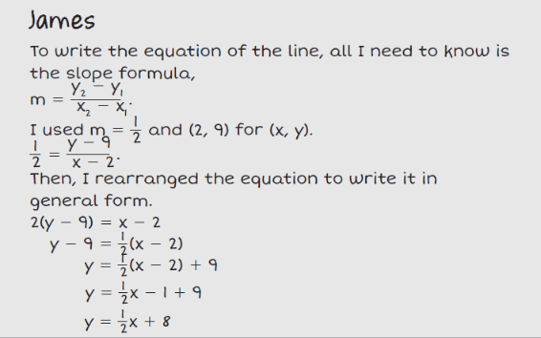
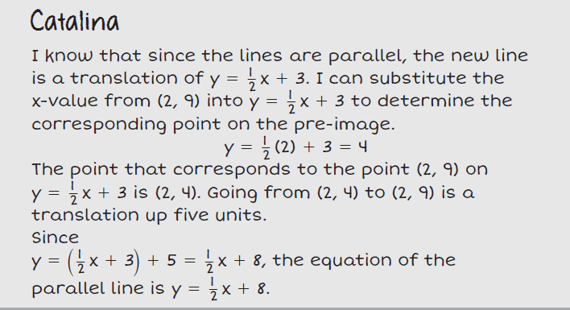
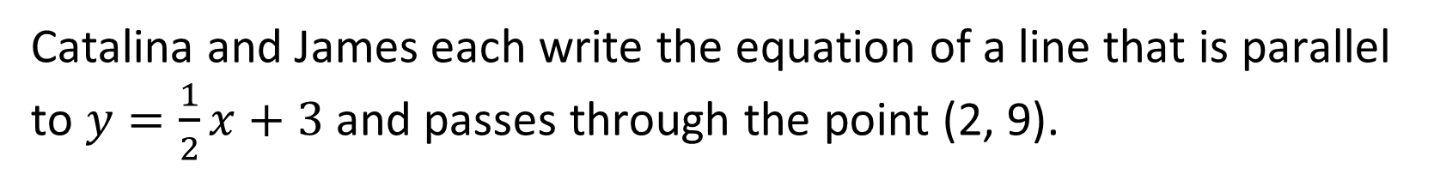
Slopes of Parallel Lines (5 of 8)
Catalina and James each write the equation of a line that is parallel to $y=\frac{1}{2}x+3$ and passes through the point (2, 9).
★ Essential · SE p. 276
33
Notes:
Questions to Support Discourse – Probing:
Why did Catalina substitute the value of x into her equation?
How was the value of y when x = 2 helpful to Catalina?
How did Catalina know the translation was up 5 units rather than down 5 units?
Questions to Support Discourse – Reflecting and Justifying:
Why did James use both the x-value and the y-value in his substitution step, but Catalina only used the x-value in her substitution step?
Questions to Support Discourse – Seeing Structure:
How did you get the slope of your equation?
How did you use the given point to write the equation of the line?

Slide 34
Slopes of Parallel Lines (6 of 8)
Which student’s method do you prefer and why?
Write the equation of a line that is parallel to y = −3x − 1 and passes through the point (−1, 5).
Answers will vary. Catalina translates the given line up 5; James uses the slope formula with the point (2, 9). Both get y = (1/2)x + 8.
y = −3x + 2
Parallel, so the slope is −3: 5 = −3(−1) + b, so b = 2.
★ Essential · SE p. 276
34
Notes:
Questions to Support Discourse – Probing:
Why did Catalina substitute the value of x into her equation?
How was the value of y when x = 2 helpful to Catalina?
How did Catalina know the translation was up 5 units rather than down 5 units?
Questions to Support Discourse – Reflecting and Justifying:
Why did James use both the x-value and the y-value in his substitution step, but Catalina only used the x-value in her substitution step?
Questions to Support Discourse – Seeing Structure:
How did you get the slope of your equation?
How did you use the given point to write the equation of the line?
Q1 has no single answer; let students defend either method.

Slide 35
Slopes of Parallel Lines (7 of 8)
Let’s summarize our learning from Activity 1.2!
★ Essential · SE p. 276
35
Notes:
Activity 1.2 Summary:
A line and its translation are parallel to one another.

Slide 36
Slopes of Parallel Lines (8 of 8)
★ Essential · SE p. 276
36
Notes:
Note: This slide is blank for optional use with displaying work.

Slide 37
Activity 1.3
★ Essential activity: do not skip
1.3
20–25
37
Notes:
Note: Total time of 20-25 minutes allotted for Activity 1.3.

Slide 38
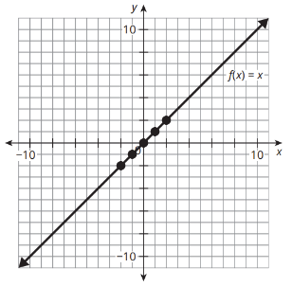
Vertical Dilations of Functions (1 of 9)
In this activity, let’s consider how dilations impact the graph of the linear function f(x) = x.
Suppose the output values of f(x) are changed by a factor of 4 to create a(x).
    Sketch the graph of a(x) and complete the table of values.
Original Graph
Transformed Graph
Graph a(x): through (0, 0) and (1, 4)
x | f(x)
−2 | −2
−1 | −1
0 | 0
1 | 1
2 | 2
x | a(x)
−2
−1
0
1
2
−8
−4
0
4
8
★ Essential · SE p. 277
38
Notes:
Questions to Support Discourse – Gathering:
Why is this transformation called a vertical dilation?
Questions to Support Discourse – Probing:
How did you complete the table?
How is the graph affected by the dilation by a factor of 4?
How do you think the graph would be affected by a factor of 10?
How did you determine the slope? The y-intercept?
Questions to Support Discourse – Seeing Structure:
How can you tell from the equation that a dilation occurred?

Slide 39
Vertical Dilations of Functions (2 of 9)
    Identify the slope and y-intercept of the function a(x). Then, write the equation for the function a(x) in general form.
Slope: 4; y-intercept: (0, 0)
a(x) = 4x
★ Essential · SE p. 277
39
Notes:
Questions to Support Discourse – Gathering:
Why is this transformation called a vertical dilation?
Questions to Support Discourse – Probing:
How did you complete the table?
How is the graph affected by the dilation by a factor of 4?
How do you think the graph would be affected by a factor of 10?
How did you determine the slope? The y-intercept?
Questions to Support Discourse – Seeing Structure:
How can you tell from the equation that a dilation occurred?

Slide 40
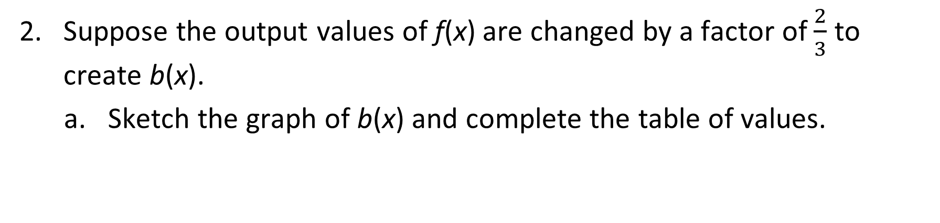
Vertical Dilations of Functions (3 of 9)
Suppose the output values of f(x) are changed by a factor of $\frac{2}{3}$ to create b(x).
    Sketch the graph of b(x) and complete the table of values.
Original Graph
Transformed Graph
Graph b(x): through (0, 0) and (3, 2)
x | f(x)
−2 | −2
−1 | −1
0 | 0
1 | 1
2 | 2
x | b(x)
−2
−1
0
1
2
−4/3
−2/3
0
2/3
4/3
★ Essential · SE p. 277
40
Notes:
Questions to Support Discourse – Probing:
Why isn’t the transformed line as steep as the original line?
What is the slope of a line less steep than b(x)?
What is the slope of a line that lies between f(x) and b(x)?
Why did the y-intercept remain at the origin?
Describe two ways the graph of c(x) is different from the graph of f(x).
How does the factor of 4 affect the graph?
How does multiplication by a negative number affect the graph?
What does a vertical stretch look like?
Why does the name vertical compression make sense?
How can you tell that the reflection is across the x-axis rather than the y-axis?

Slide 41
Vertical Dilations of Functions (4 of 9)
    Identify the slope and y-intercept of the function b(x). Then, write the equation for the function b(x) in general form.
Slope: 2/3; y-intercept: (0, 0)
b(x) = (2/3)x
★ Essential · SE p. 277
41
Notes:
Questions to Support Discourse – Probing:
Why isn’t the transformed line as steep as the original line?
What is the slope of a line less steep than b(x)?
What is the slope of a line that lies between f(x) and b(x)?
Why did the y-intercept remain at the origin?
Describe two ways the graph of c(x) is different from the graph of f(x).
How does the factor of 4 affect the graph?
How does multiplication by a negative number affect the graph?
What does a vertical stretch look like?
Why does the name vertical compression make sense?
How can you tell that the reflection is across the x-axis rather than the y-axis?

Slide 42
Vertical Dilations of Functions (5 of 9)
Suppose the output values of f(x) are changed by a factor of −4 to create c(x).
    Sketch the graph of c(x) and complete the table of values.
Original Graph
Transformed Graph
Graph c(x): through (0, 0) and (1, −4)
x | f(x)
−2 | −2
−1 | −1
0 | 0
1 | 1
2 | 2
x | c(x)
−2
−1
0
1
2
8
4
0
−4
−8
★ Essential · SE p. 277
42
Notes:
Questions to Support Discourse – Probing:
Why isn’t the transformed line as steep as the original line?
What is the slope of a line less steep than b(x)?
What is the slope of a line that lies between f(x) and b(x)?
Why did the y-intercept remain at the origin?
Describe two ways the graph of c(x) is different from the graph of f(x).
How does the factor of 4 affect the graph?
How does multiplication by a negative number affect the graph?
What does a vertical stretch look like?
Why does the name vertical compression make sense?
How can you tell that the reflection is across the x-axis rather than the y-axis?

Slide 43
Vertical Dilations of Functions (6 of 9)
    Identify the slope and y-intercept of the function c(x). Then, write the equation for the function c(x) in general form.
Slope: −4; y-intercept: (0, 0)
c(x) = −4x
★ Essential · SE p. 277
43
Notes:
Questions to Support Discourse – Probing:
Why isn’t the transformed line as steep as the original line?
What is the slope of a line less steep than b(x)?
What is the slope of a line that lies between f(x) and b(x)?
Why did the y-intercept remain at the origin?
Describe two ways the graph of c(x) is different from the graph of f(x).
How does the factor of 4 affect the graph?
How does multiplication by a negative number affect the graph?
What does a vertical stretch look like?
Why does the name vertical compression make sense?
How can you tell that the reflection is across the x-axis rather than the y-axis?

Slide 44
Vertical Dilations of Functions (7 of 9)
For the parent function f(x) = x, the transformed function y = a ∙ f(x) shows a vertical dilation of the function. This dilation affects the output values, or y-values, of the function. For |a| > 1, the resulting graph vertically stretches by a factor of a units. For 0 < |a| < 1, the resulting graph vertically compresses by a factor of a units. For a < 0, the resulting graph is vertically stretched or compressed and is reflected across the x-axis.
Compare the values f(−1) and c(−1). How did the transformation of the function affect the value of the function at x = −1?
f(−1) = −1 and c(−1) = 4.
The vertical dilation multiplied the value at x = −1 by −4.
★ Essential · SE p. 279
44
Notes:
Questions to Support Discourse – Probing:
Why isn’t the transformed line as steep as the original line?
What is the slope of a line less steep than b(x)?
What is the slope of a line that lies between f(x) and b(x)?
Why did the y-intercept remain at the origin?
Describe two ways the graph of c(x) is different from the graph of f(x).
How does the factor of 4 affect the graph?
How does multiplication by a negative number affect the graph?
What does a vertical stretch look like?
Why does the name vertical compression make sense?
How can you tell that the reflection is across the x-axis rather than the y-axis?

Slide 45
Vertical Dilations of Functions (8 of 9)
Let’s revisit the Essential Question and summarize our learning from Activity 1.3!
Essential Question: How can you transform a function? What effects do different transformations have on the characteristics of linear functions?
★ Essential · SE p. 279
45
Notes:
Note: To close Day 2, have students reread the Essential Question and then read the Stamp the Learning summary aloud.
Activity 1.3 Summary:
For the parent function f(x) = x, the transformed function, a ∙ f(x), is a vertical dilation of the function. When a is negative, the function is reflected across the x-axis.

Slide 46
Vertical Dilations of Functions (9 of 9)
★ Essential · SE p. 279
46
Notes:
Note: This slide is blank for optional use with displaying work.

Slide 47
Day 3
3
47
Notes:
Note: Total suggested pacing for Day 3 is 45 minutes.

Slide 48
Essential Question (3 of 3)
How can you transform a function? What effects do different transformations have on the characteristics of linear functions?
SE p. 269
48
Notes:
Note: To begin Day 3, have a student read the Essential Question aloud.

Slide 49
Activity 1.4
★ Essential activity: do not skip
1.4
15–20
49
Notes:
Note: Total time of 15-20 minutes allotted for Activity 1.4.

Slide 50
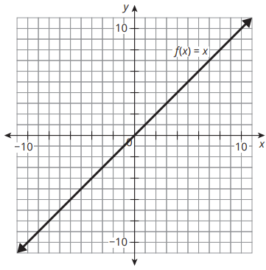
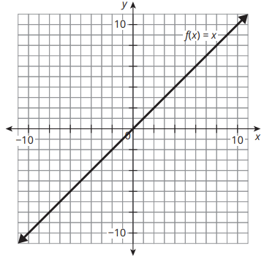
Vertical Dilations and Vertical Translations of Functions (1 of 6)
Let’s consider more transformations of the parent function f(x) = x.
Describe the transformations performed on f(x) to produce g(x). Then, graph g(x). Write the function equation in general form.
g(x) = 2 ∙ f(x) + 7
g(x) = 3 ∙ f(x) − 1
a. g(x) = 2x + 7
Vertical stretch by a factor of 2, then up 7. Graph: through (0, 7), slope 2.
b. g(x) = 3x − 1
Vertical stretch by a factor of 3, then down 1. Graph: through (0, −1), slope 3.
★ Essential · SE p. 280
50
Notes:
Questions to Support Discourse – Probing:
How did you rewrite the function in general form?
How did you graph the line? Explain your process.
Is the transformed graph a vertical stretch or compression? How can you tell from the equation and graph?
Which ordered pair in the transformed function corresponds to (1, 1) in the original function?
How is the graph affected by an a-value greater than 1? An a-value between 0 and 1? A negative a-value?
How can you describe the effects using the terms vertical stretch and vertical compression?
How is the graph affected by a d-value greater than 1? A d-value less than 1?
Slide typo: the second item is labeled 'a.'; it is item b.

Slide 51


Vertical Dilations and Vertical Translations of Functions (2 of 6)
g(x) = $\frac{1}{3}$ ∙ f(x) + 2
g(x) = $\frac{1}{2}$ ∙ f(x) − 3
g(x) = (1/3)x + 2
Vertical compression by a factor of 1/3, then up 2. Graph: through (0, 2), slope 1/3.
g(x) = (1/2)x − 3
Vertical compression by a factor of 1/2, then down 3. Graph: through (0, −3), slope 1/2.
★ Essential · SE p. 280
51
Notes:
Questions to Support Discourse – Probing:
How did you rewrite the function in general form?
How did you graph the line? Explain your process.
Is the transformed graph a vertical stretch or compression? How can you tell from the equation and graph?
Which ordered pair in the transformed function corresponds to (1, 1) in the original function?
How is the graph affected by an a-value greater than 1? An a-value between 0 and 1? A negative a-value?
How can you describe the effects using the terms vertical stretch and vertical compression?
How is the graph affected by a d-value greater than 1? A d-value less than 1?

Slide 52

Vertical Dilations and Vertical Translations of Functions (3 of 6)
g(x) = −1 ∙ f(x) − 4
g(x) = $−\frac{2}{3}$ ∙ f(x) + 5
g(x) = −x − 4
Reflection across the x-axis, then down 4. Graph: through (0, −4), slope −1.
g(x) = −(2/3)x + 5
Reflection across the x-axis and vertical compression by a factor of 2/3, then up 5. Graph: through (0, 5), slope −2/3.
★ Essential · SE p. 280
52
Notes:
Questions to Support Discourse – Probing:
How did you rewrite the function in general form?
How did you graph the line? Explain your process.
Is the transformed graph a vertical stretch or compression? How can you tell from the equation and graph?
Which ordered pair in the transformed function corresponds to (1, 1) in the original function?
How is the graph affected by an a-value greater than 1? An a-value between 0 and 1? A negative a-value?
How can you describe the effects using the terms vertical stretch and vertical compression?
How is the graph affected by a d-value greater than 1? A d-value less than 1?
Slide typo: the first item is labeled 'a.'; it is item e.

Slide 53
Vertical Dilations and Vertical Translations of Functions (4 of 6)
When a function is both translated and stretched vertically, the resulting function can be written in the form a ∙ f(x) + d, where d represents the vertical translation of f(x), and a represents the vertical dilation of f(x).
Consider the function g(x) = a ∙ f(x) + d.
  How does changing the a-value affect the slope of the function? The y-intercept of the function?
  How does changing the d-value affect the slope of the function? The y-intercept of the function?
a. a changes the slope (for f(x) = x the slope becomes a: |a| > 1 steeper, 0 < |a| < 1 less steep, a < 0 reflected). It does not change the y-intercept.
b. d does not change the slope. It changes the y-intercept to (0, d): d > 0 moves the line up, d < 0 moves it down.
★ Essential · SE p. 281
53
Notes:
Questions to Support Discourse – Probing:
How did you rewrite the function in general form?
How did you graph the line? Explain your process.
Is the transformed graph a vertical stretch or compression? How can you tell from the equation and graph?
Which ordered pair in the transformed function corresponds to (1, 1) in the original function?
How is the graph affected by an a-value greater than 1? An a-value between 0 and 1? A negative a-value?
How can you describe the effects using the terms vertical stretch and vertical compression?
How is the graph affected by a d-value greater than 1? A d-value less than 1?
TE correction (part a): the TE says the slope 'increases' when a > 1 or a < −1 and 'decreases' between −1 and 1. That describes steepness, not slope: for a = −3 the slope is −3. For f(x) = x the new slope is a.

Slide 54
Vertical Dilations and Vertical Translations of Functions (5 of 6)
Let’s summarize our learning from Activity 1.4!
★ Essential · SE p. 281
54
Notes:
Activity 1.4 Summary:
When a function is both translated and stretched vertically, the resulting function can be written in the form 𝑎 ∙ 𝑓(𝑥) + 𝑑, where 𝑑 represents the vertical translation of f(x) and 𝑎 represents the vertical dilation of f(x).

Slide 55
Vertical Dilations and Vertical Translations of Functions (6 of 6)
★ Essential · SE p. 281
55
Notes:
Note: This slide is blank for optional use with displaying work.

Slide 56
Activity 1.5
1.5
15–20
56
Notes:
Note: Total time of 15-20 minutes allotted for Activity 1.5.

Slide 57
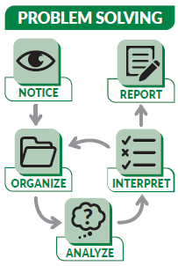
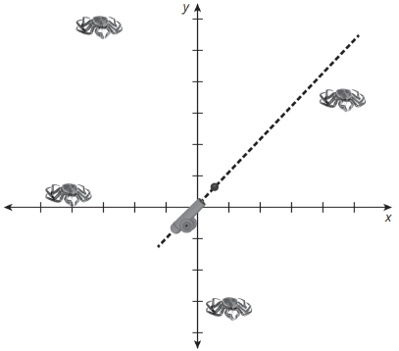
Applying Linear Function Transformations (1 of 6)
Your company is developing a new video game for kids, which involves scoring points by shooting targets with a cannon. The cannon starts at the origin of a coordinate system as shown.
SE p. 282
57

Slide 58
Applying Linear Function Transformations (2 of 6)
By default, it shoots along the line f(x) = x. Players can move the cannon up and down the y-axis and also change the angle of the cannon. When a player shoots the cannon, the game program determines the values of a and d for the linear function a ∙ f(x) + d. If the target is on that line, the program will show an animation of the cannonball hitting the target.
SE p. 282
58

Slide 59
Applying Linear Function Transformations (3 of 6)
Test the program. Determine values for a and d for four linear functions that should hit the targets shown.
Identify the domain on which each graph hits the target.
Ask Yourself…
The cannon can shoot in only one direction. Does that affect the domain or range of the linear function?
Sample: a = 0 with d = 6, 4, 1 and −3: horizontal lines through each target (move the cannon to (0, d)).
The cannon shoots in only one direction. Targets in Quadrant II (left of the y-axis): domain x ≤ 0. Targets in Quadrants I and IV: domain x ≥ 0.
SE p. 282
59
Notes:
Questions to Support Discourse – Seeing Structure:
How can you write an equation to change the cannon’s angle? The cannon’s location on the y-axis?
Questions to Support Discourse – Gathering:
What are the approximate coordinates of the target in Quadrant I?
Questions to Support Discourse – Probing:
How could you hit the targets with horizontal lines?
For Version B, why is the a-value the same every time?
For Version B, how did you identify the d-value that would hit the target?
When using Version C, how did you know when you needed a negative a-value?
Questions to Support Discourse – Seeing Structure:
Which version of the game uses only a translation?
Which version of the game uses only a dilation?

Slide 60
Applying Linear Function Transformations (4 of 6)
The game developer is also testing two other versions of the game, with different abilities for the cannon.
Version B
The cannon can only shoot along a line parallel to f(x) = x or f(x) = −x. It can move up and down the y-axis.
Version C
The cannon can change angles but remains fixed at the origin.
Determine the values for a and d, along with their corresponding domains, for four linear functions that can hit the targets in each version of the game. Show your work.
B (a = ±1, move d), clockwise from top left: a = −1, d = 2 (x ≤ 0); a = 1, d = −1 (x ≥ 0); a = −1, d = −2 (x ≥ 0); a = −1, d = −4 (x ≤ 0)
C (d = 0, change a), clockwise from top left: a = −3/2 (x ≤ 0); a = 4/5 (x ≥ 0); a = −3 (x ≥ 0); a = −1/5 (x ≤ 0)
SE p. 283
60
Notes:
Questions to Support Discourse – Seeing Structure:
How can you write an equation to change the cannon’s angle? The cannon’s location on the y-axis?
Questions to Support Discourse – Gathering:
What are the approximate coordinates of the target in Quadrant I?
Questions to Support Discourse – Probing:
How could you hit the targets with horizontal lines?
For Version B, why is the a-value the same every time?
For Version B, how did you identify the d-value that would hit the target?
When using Version C, how did you know when you needed a negative a-value?
Questions to Support Discourse – Seeing Structure:
Which version of the game uses only a translation?
Which version of the game uses only a dilation?
The targets, read from the picture as the TE does: (−4, 6), (5, 4), (1, −3), (−5, 1). Other answers: Version B also a = 1, d = 10; a = −1, d = 9; a = 1, d = −4; a = 1, d = 6. TE correction: for the lower Quadrant II target the TE's alternative a = 1, d = 4 gives y = x + 4, which misses (−5, 1); it is d = 6. The TE's Version C slope −6/4 simplifies to −3/2.

Slide 61
Applying Linear Function Transformations (5 of 6)
Let’s summarize our learning from Activity 1.5!
SE p. 283
61
Notes:
Activity 1.5 Summary:
Linear function transformations are used in real-life situations.

Slide 62
Applying Linear Function Transformations (6 of 6)
SE p. 283
62
Notes:
Note: This slide is blank for optional use with displaying work.

Slide 63
Talk the Talk
5
63
Notes:
Note: Total time of 5 minutes allotted for the Talk the Talk.

Slide 64
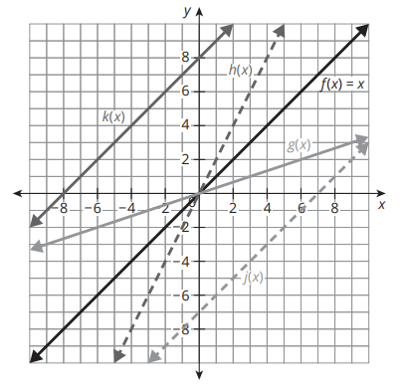
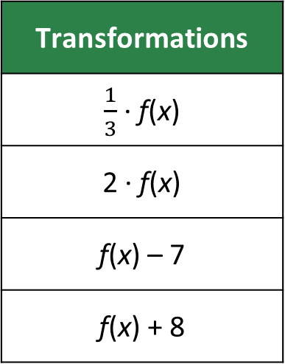
Function Matching (1 of 4)
The graph shows the linear function f(x) = x and four transformations of f(x).
Transformations
$\frac{1}{3}$ ∙ f(x)
2 ∙ f(x)
f(x) – 7
f(x) + 8
SE p. 284
64

Slide 65
Function Matching (2 of 4)
Match each transformed graph to one of the transformations in the table. Explain your reasoning.
k(x) = _______________
h(x) = _______________
g(x) = _______________
j(x) = _______________
Ask Yourself…
Did you justify your mathematical reasoning?
f(x) + 8
2 · f(x)
(1/3) · f(x)
f(x) − 7
k(x): f(x) translated up 8 units.
h(x): f(x) stretched vertically by a factor of 2 (through the origin, steeper).
g(x): f(x) compressed vertically by a factor of 1/3 (through the origin, less steep).
j(x): f(x) translated down 7 units.
SE p. 284
65
Notes:
Questions to Support Discourse – Probing:
Which characteristic of the line did you use to identify it?
Which two lines included a vertical dilation? How can you tell which a-value applies to each line?
Which two lines included a vertical translation?
How can you tell which d-value applies to each line?

Slide 66
Function Matching (3 of 4)
Let’s answer the Essential Question and summarize our learning from the Talk the Talk!
Essential Question: How can you transform a function? What effects do different transformations have on the characteristics
of linear functions?
SE p. 284
66
Notes:
Note: To close Day 3, have students read and answer the Essential Question and then read the Stamp the Learning summary aloud.
Essential Question:
Sample answer: For the parent function f(x) = x, the transformed function y = f(x) + d shows a vertical translation of the function. For 𝑑 > 0, the resulting graph vertically shifts up. For 𝑑 < 0, the resulting graph vertically shifts down. The parent function and the resulting graph are parallel because they have the same slope but different y-intercepts. The transformed function y = af(x) shows a vertical dilation of the function. For |𝑎| > 1, the resulting graph vertically stretches by a factor of a units. For 0 < |𝑎| < 1 the resulting graph vertically compresses by a factor of a units. For 𝑎 < 0, the resulting graph is vertically stretched or compressed and is reflected across the x-axis.
Talk the Talk Summary:
An equation can be generated given the graph of a function transformation.

Slide 67
Function Matching (4 of 4)
SE p. 284
67
Notes:
Note: This slide is blank for optional use with displaying work.

Slide 68
Teacher Edition corrections in this deck
• Activity 1.4 Q2a: the TE says the slope 'increases' or 'decreases'; it means steepness. For f(x) = x the new slope is a.
• Activity 1.5 Q3 Version B: for the lower Quadrant II target (−5, 1), the TE's a = 1, d = 4 misses; it is a = 1, d = 6.
• Prepare Q1: the TE gives f(x) = (2/3)x − 5. The graph's points give f(x) = (2/3)x − 14/3.
• Slide typos: slide 50's second item 'a.' is b; slide 52's first item 'a.' is e.
• Every other TE answer was re-solved and is correct, including the Assignment (pp. 285-286) and Prepare Q2.
68

Slide 69
Prepare
69
Notes:
How can you identify whether students are ready for new learning? ​
Depending on available time, you can assign the Prepare section of the Lesson Assignments as homework or as a warm-up to identify students' prior knowledge for the upcoming lesson's activities.

Slide 70
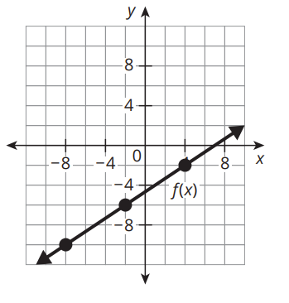
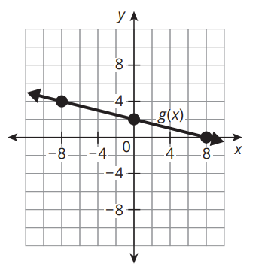
Prepare for Module 2 Topic 2 Lesson 2
Write a linear function for each graph.
1.
2.
f(x) = (2/3)x − 14/3
g(x) = −(1/4)x + 2
SE p. 286
70
Notes:
TE correction: the TE gives f(x) = (2/3)x − 5. The marked points (−8, −10), (−2, −6) and (4, −2) give slope 2/3 and y-intercept (0, −14/3), so f(x) = (2/3)x − 14/3.

Slide 71
Acknowledgment and Notice
71

Slide 72
BLMATH_AlgI_M2_T2_L1_DCS_ENG
72

